Slide 1
CSCIU 210 01 Computer Organization AKM Jahangir A Majumder, PhD
Fall 2018 - Lecture 1
August 24, 2018
Note: Some slides are adapted from those used by previous instructors and some slides include figures from the textbook.

Slide 2
Instructor Information
Lecture MWF 11:30am-12:20pm Hodge 254
Instructor: AKM Jahangir Alam Majumder
Office: Hodge 239
Office hours: MW 9:30-11:00am, W 1:00 -2:00pm; other times by appointment
E-mail: majumder@uscupstate.edu Phone: 864-503-5206

Slide 3
Course Description (Bullet Form)
This course studies basic concepts of a computer system and introduces.
Principles of Von Neumann computer architecture
Data representation, computer arithmetic, memory hierarchy
CPU structure and instruction sets, assembly language programming
Performance considerations and alternative computer architectures
The course illustrate the theories and concepts of computer systems and design, as well as their applications to real-world problems.

Slide 4
Textbook, Prerequisite, and Co-requisite
Required textbook:
Computer Organization and Design: The Hardware/Software Interfaces
David A. Patterson, John L. Hennessy
4th / RISC V-edition, ISBN: 978-0-12-812275-4 (required). See me if you have an older edition.
Textbook Companion Web-Site: (https://textbooks.elsevier.com/web/product_details.aspx?isbn=9780128122754).
Software: SPIM Simulator whose download link is included in the textbook companion CD.

Slide 5
Grading Determination
Homework 15%
Quizzes 20%
Exam 1 20%
Exam 2 20%
Final Exam 25%

Slide 6
Letter Grade Assignment
A : 90% or above
B+ : 85%~89%
B : 80%~84%
C+ : 75%~79%
C : 70%~74%
D+ : 65%~69%
D : 60%~64%
F : below 60%

Slide 7
Attendance Policy
If you miss class, you are responsible for all announcements and material covered. You may contact your instructor for assistance, but it is your responsibility
If you are going to miss class due to a university or religious activity, you must notify your instructor during the first two weeks of the semester

Slide 8
Quizzes and Homework
Homework will be assigned regularly (posted on Blackboard)
Regular quizzes will be given. The quiz problems will be related to the homework, but do not expect them to be identical. Doing a good job on the homework is extremely important to your success in the course!

Slide 9
Exams and Quizzes
The exams will not be a repeat of the homework problems and examples done in lecture. To succeed, you must learn the fundamental concepts that can be applied to a wide variety of problems
Exams and quizzes will be closed book, closed notes, etc.
Unless agreed to in advance, no makeup exams or quizzes will be given except in case of a medically documented incapacity or a documented family emergency
Good exam grades lead to good Final Grade!

Slide 10
Calculator
On quizzes and exams, the only allowed electronic device is a basic, memoryless calculator for doing computations. If you do not have one, please get one before the first quiz. If you have difficulty obtaining one or have questions about whether a calculator qualifies, please see your instructor as soon as possible, and no later than the second week of classes.

Slide 11
Re-grades
If you want a quiz or exam to be regraded, you must submit your request in writing no later than one week after the graded quiz/exam is made available to you.

Slide 12
NOTA BENE
As part of the Department's ongoing assessment process, selected student work may be copied and shared with accreditation evaluators as appropriate. If you have any objections to this, please notify your instructor in writing by the end of the first week.

Slide 13
Any Question?

Slide 14
Why CSCIU 210?
You want to call yourself a “computer scientist.”
You want to build software people use (need performance).
You need to make a purchasing decision or offer “expert” advice.

Slide 15
Where are we headed?
Performance Evaluation (Chapter 1)
Logic Design and Binary Math (Appendix C and Chapter 2 and 3)
First Exam
MIPS Assembly Language (Chapter 2 and 3)
MIPS Computer Architecture (Chapter 4)
Second Exam
Pipeline (Chapter 4)
Memory and Other Interesting Ideas (Chapter 5, If time permitted)
Final Exam (Comprehensive)

Slide 16
Chapter 1
Computer Abstractions and Technology

Slide 17
The Computer Revolution
Progress in computer technology
Underpinned by Moore’s Law
Makes novel applications feasible
Computers in automobiles
Smartphones
Human genome project
World Wide Web
Search Engines
Computers are pervasive

Slide 18
Classes of Computers
Desktop computers
Micro/Mini Computers
General purpose, variety of software
Subject to cost/performance tradeoff
Server computers
Network based
High capacity, performance, reliability
Range from small servers to building sized
Embedded computers
Hidden as components of systems
Stringent power/performance/cost constraints

Slide 19
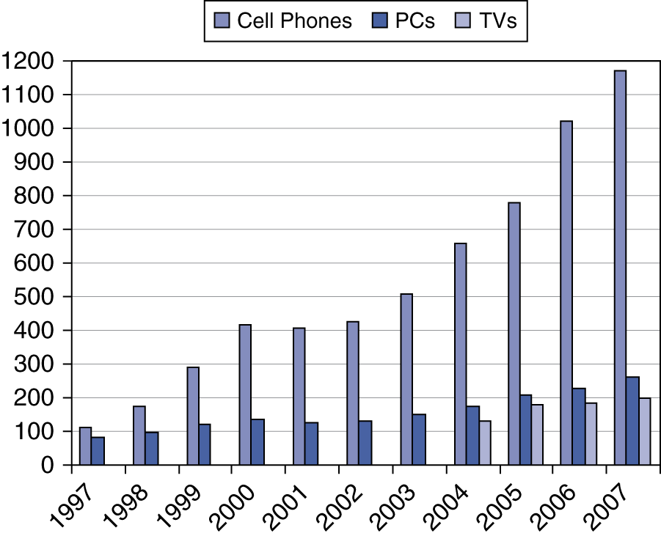
The Processor Market
Millions

Slide 20
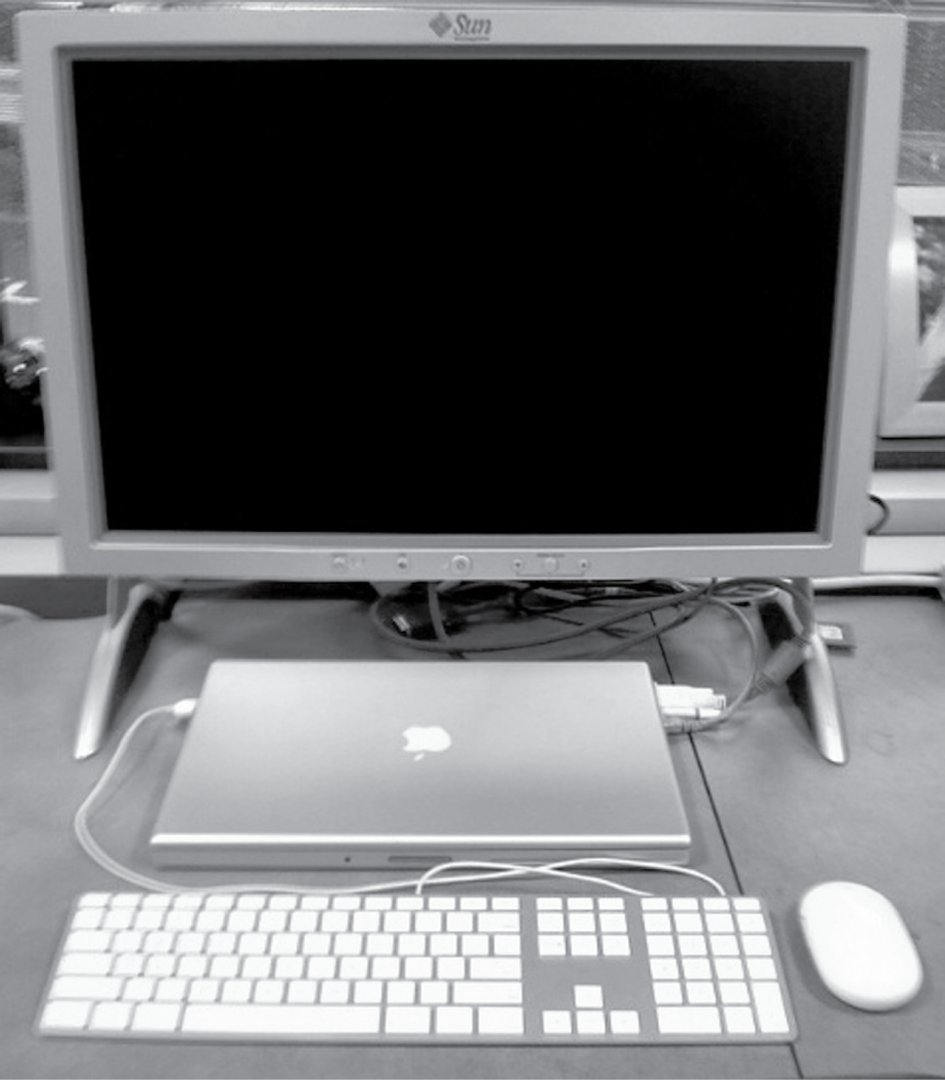
Anatomy of a Computer
Output device
Network cable
Input device
Input device

Slide 21
Overview of Physical Implementations
The hardware out of which we make systems
Integrated Circuits (ICs)
Combinational logic circuits, memory elements, analog interfaces.
Printed Circuits (PC) boards
Substrate for ICs and interconnection, distribution of CLK, Vdd, and GND signals, heat dissipation.
Power Supplies
Converts line AC voltage to regulated DC low voltage levels.
Chassis (rack, card case, ...)
holds boards, power supply, provides physical interface to user or other systems.
Connectors and Cables.

Slide 22
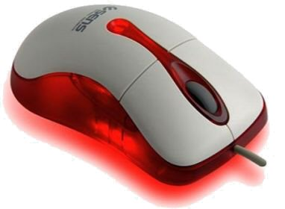
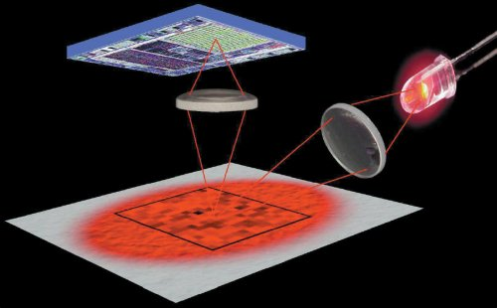
Anatomy of a Mouse
Optical mouse
LED illuminates desktop
Small low-resolution camera
Basic image processor
Looks for x, y movement
Buttons & wheel
Supersedes roller-ball mechanical mouse

Slide 23
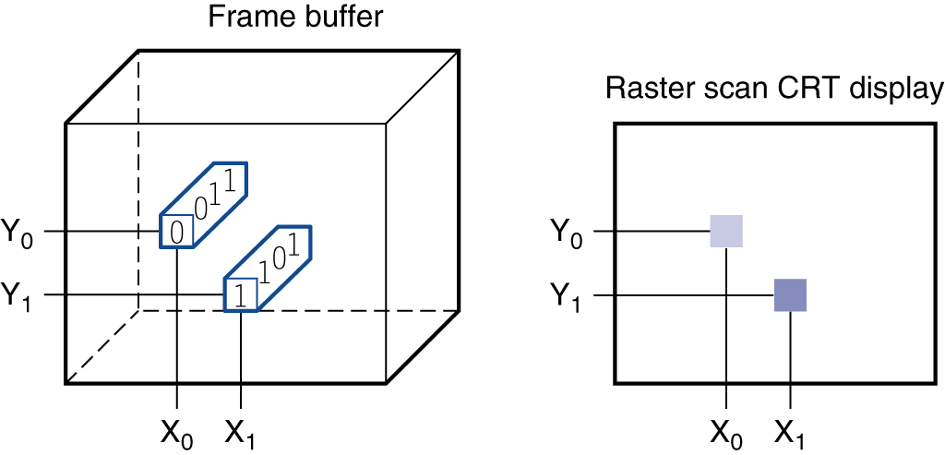
Through the Looking Glass
LCD screen: picture elements (pixels)
Mirrors content of frame buffer memory

Slide 24
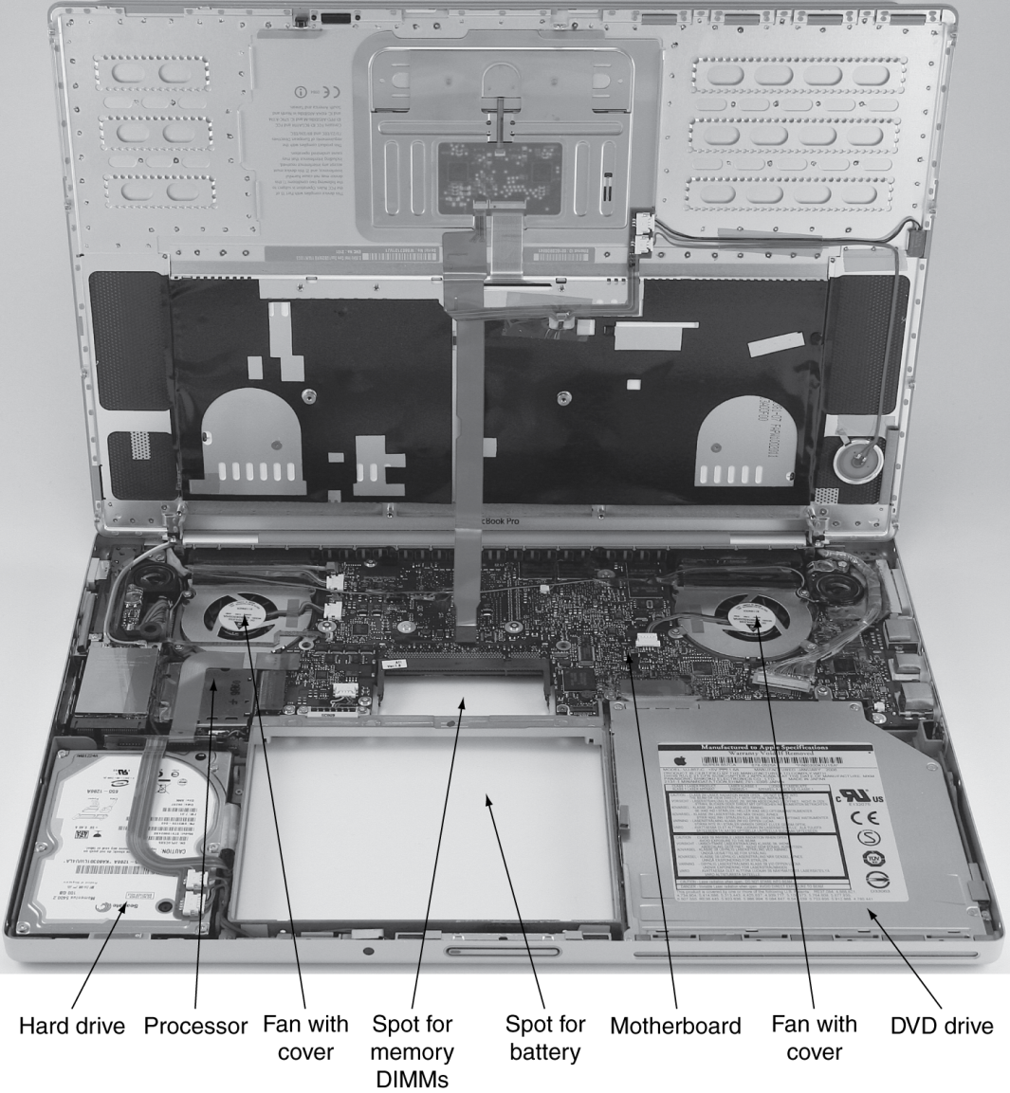
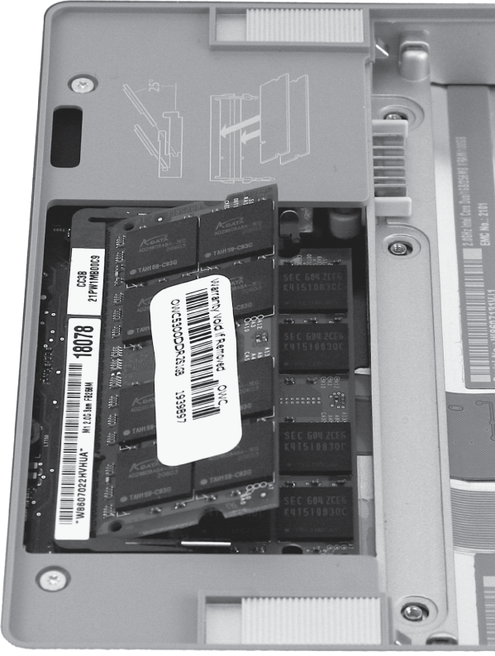
Opening the Box

Slide 25
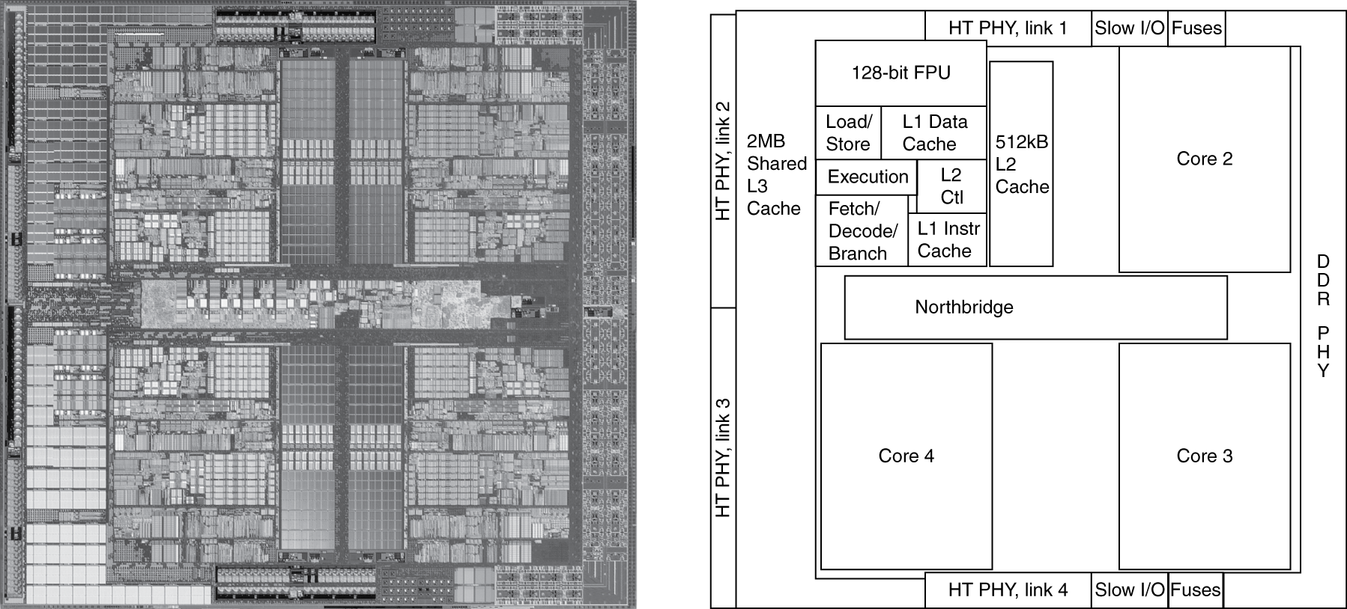
Inside the Processor
AMD Barcelona: 4 processor (microprocessor) cores
Datapath and control

Slide 26
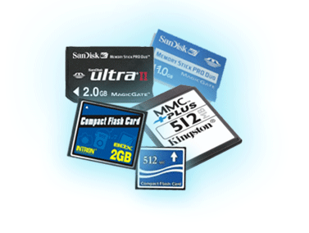
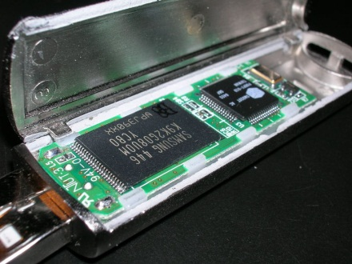
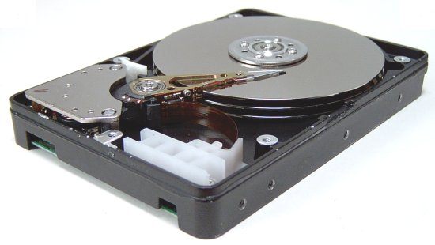
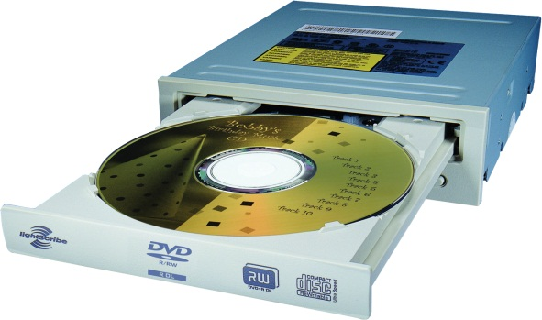
A Safe Place for Data
Volatile main/primary memory
Loses instructions and data when power off
Non-volatile secondary memory
Magnetic disk
Flash memory
Optical disk (CDROM, DVD)

Slide 27
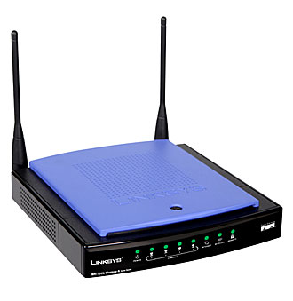
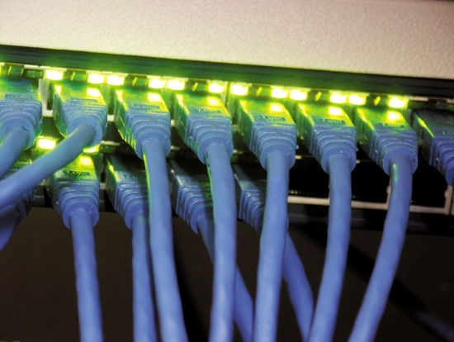
Networks
Communication and resource sharing
Local area network (LAN): Ethernet
Within a building
Wide area network (WAN): the Internet
Wireless network: Wi-Fi, Zigbee, Bluetooth

Slide 28
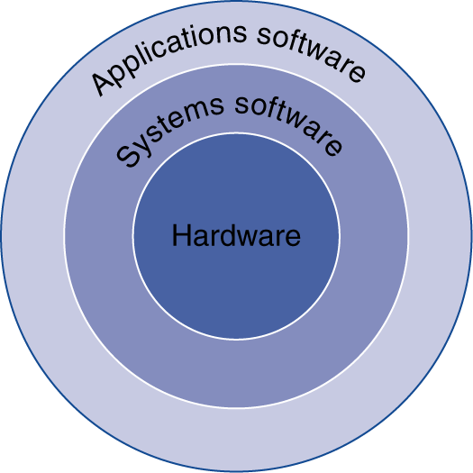
Below Your Program
Application software
Written in high-level language (HLL)
System software
Compiler: translates HLL code to machine code
Operating System: service code
Handling input/output
Managing memory and storage
Scheduling tasks & sharing resources
Hardware
Processor, memory, I/O controllers

Slide 29
How Do Computers Work?
Need to understand abstractions such as:
Applications software
Systems software
Assembly Language
Machine Language
Architectural Issues: i.e., Caches, Virtual Memory, Pipelining
Sequential logic, finite state machines
Combinational logic, arithmetic circuits
Boolean logic, 1s and 0s
Transistors used to build logic gates (CMOS)
Semiconductors/Silicon used to build transistors
Properties of atoms, electrons, and quantum dynamics
So much to learn!

Slide 30
What You Will Learn
How programs are translated into the machine language
And how the hardware executes them
The hardware/software interface
What determines program performance
And how it can be improved
How hardware designers improve performance
What is parallel processing

Slide 31
Abstractions
Abstraction helps us deal with complexity
Hide lower-level detail
Instruction set architecture (ISA)
The hardware/software interface
Application binary interface
The ISA plus system software interface
Implementation
The details underlying and interface

Slide 32
Summary
We described different types of computer today.
We will begin to cover Instruction Set Architecture (ISA), computer model and performance the next time.

